Slide 1

ILLUMINATI GAME
Surya S Das
Brian Cabral
Nayna Gajera
Daniel Gione

Slide 2

Table of Contents
Slide #
3. Vision Document
4. Project Plan
5. Use Cases
6. Test Plan
7. Flow Chart
9. User Manual
10. Implementation

Slide 3
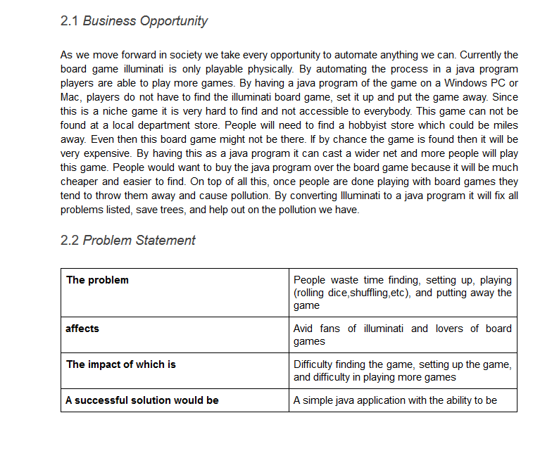
Vision Document
In this document we discuss the scope of the game. Our scope is as follows:
Will be made in Java
Designed to run on Windows 7 64 bit PCs and on Mac PCs
Limited UI because it is mainly a text based game
Link:
https://docs.google.com/document/d/1tfQclNDtm1PEH504qjlGoXWDnbfHIuL7sRjmfTsTD6o/edit?usp=sharing

Slide 4
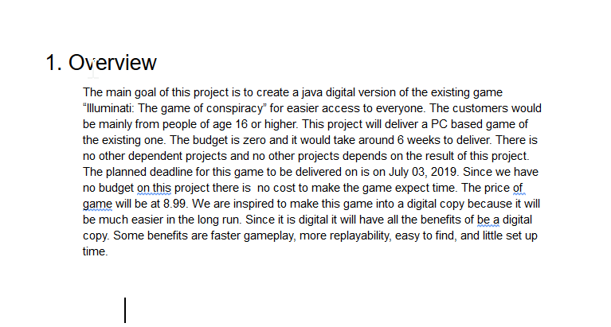
Project Plan
Overview:
The purpose of the game to make it streamlined through Java. This will make the game easier to acquire as it is already hard to acquire since it is a niche board game.
Exclusions:
Tablets, phones and Linux based machines
In Game Tutorial
Microtransactions
In this document we wrote out what risks we may have. For example not being able to complete the software is a high risk we have
Link:
https://docs.google.com/document/d/1l6rpvSms8Jn5j5lI_H3BYnIfV-sWTwTJKvWY0I4Dg_Q/edit?usp=sharing

Slide 5
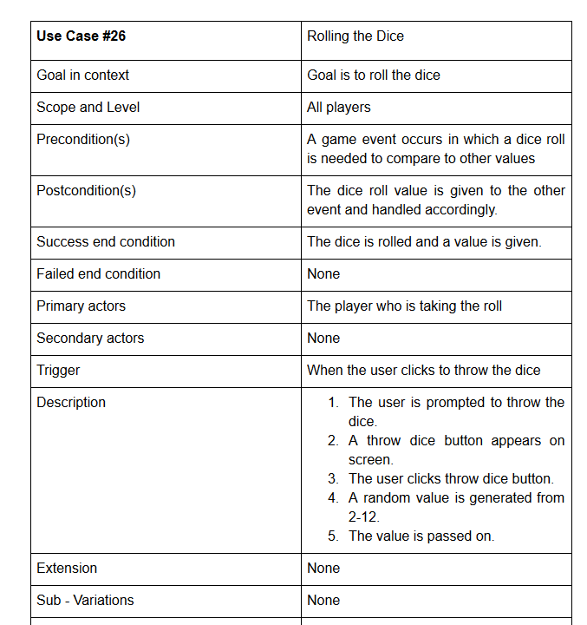
Use Cases
In this document we describe each case a user may encounter within the game. We describe things such as the actors that are participating in the case, what triggers the case, description of the case, other such information. One example of a used case we used is the case of rolling the dice. In this case the actor is the player rolling the dice. The thing that triggers this case is when the actor is deciding who is going first. This then rolls the dice.
Link:
https://docs.google.com/document/d/1yEKXc2olFw-WGHYPwsBMicF_BZUEGN7gOPAmnZMMnq0/edit?usp=sharing

Slide 6
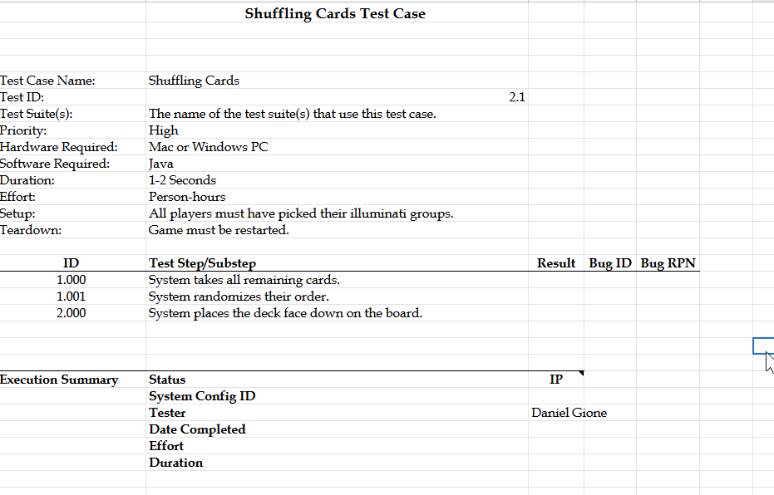
Test Plan
In this document we decide what needs to be tested in the program. We write down what the expected results and then we check and verify what the actual results are.
Test Link:
https://docs.google.com/document/d/16Ilk119YqKy53IRHTkXqx-X-zJt-L1wh2xEaAyiYmA0/edit?usp=sharing
Test case Link:
https://docs.google.com/spreadsheets/d/1nPXJRxpvoJpF8hp5wcl-CdlQm9yFEpFcPvTciMGyYVY/edit?usp=sharing

Slide 7
Flow Chart
The flowchart we made reflects the game logice of the game. We stated that our game logic begins when the game starts. This skips the main menu and the steps before starting the gaming. It also stops when the game is over. The flow chart shows all possible decisions the player may encounter. The chart then shows what the next step is going to be.

Slide 8
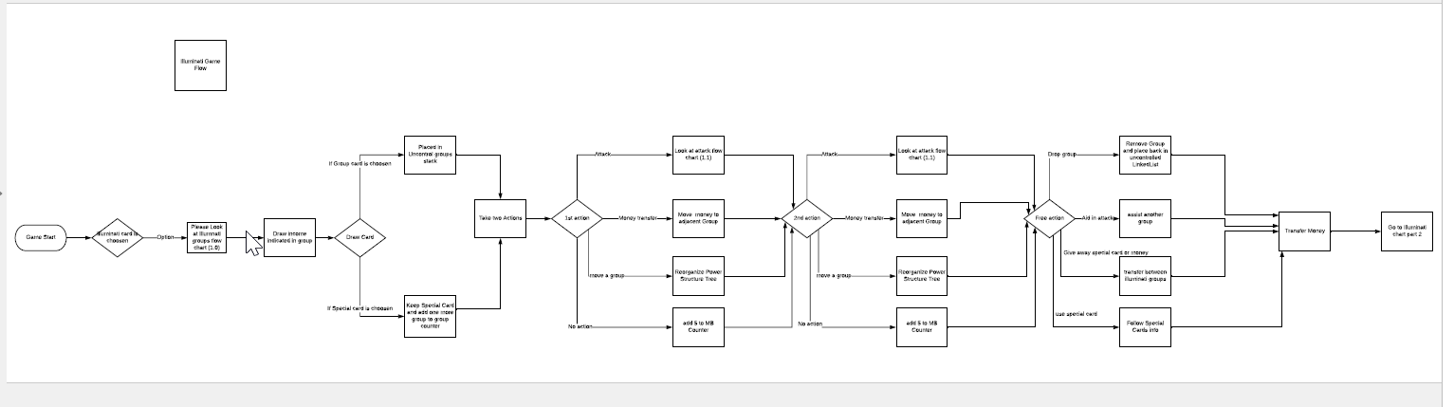
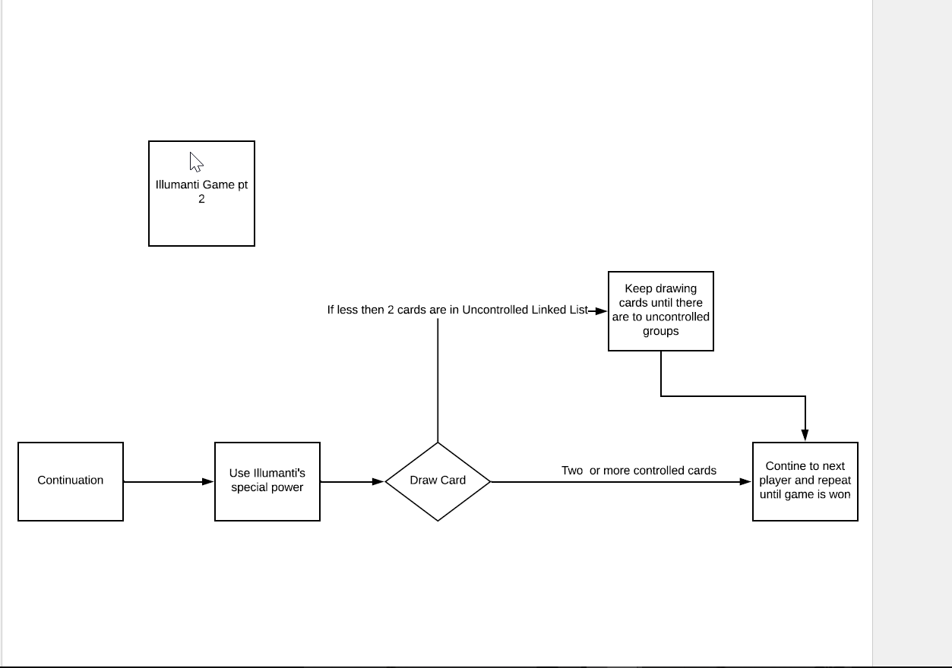

Slide 9
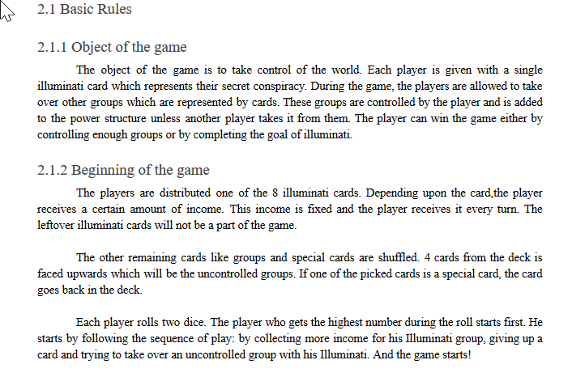
User Manual
For the user manual we took a lot of inspiration from the actual board game manual. We differ from our game manual because our game is in Java and not in an actual physical board. In the manual we go more in detail to how the game flow is.
Link:
https://docs.google.com/document/d/1GxxptI3o08EG3l5FJL8mR0sRg25d6XhLQKQZ7w36qJE/edit?usp=sharing

Slide 10
Implementation
The coding part of the project is done using Java language and the user can interact with the code using text feature. Further details is given through the demonstration.

